Slide 1
DATA STRUCTURES (CS3401)
Dr. Somaraju Suvvari,
Asst. Prof, Dept. of CSE, NIT Patna.
somaraju@nitp.ac.in;

Slide 2
The Course
DATA STRUCTURES

Slide 3
Study Material
Data Structures and Algorithm Analysis in C. Mark Allen Weiss, Pearson Education, Second Edition, 2001.
Fundamentals of Data Structures. E. Horowitz, S. Sahni, Computer Science Press, 2nd Edition, 2008.
Data Structure and Program Design. R. L Kruse, Prentice Hall, 2nd Edition, 1996
Data Structures and Algorithms Made Easy. Narasimha Karumanchi, Career Monk, 5th Edition, 2017.
Introduction to Algorithms. Thomas H. Cormen, Charles E. Leiserson, Ronald L. Rivest, Clifford Stein, 2nd Edition, MIT Press, 2001.

Slide 4
The schedule
Tuesday 09.30 to 11.30
Section A and Section B
Friday 13.30 to 15.30
Section A and Section B

Slide 5
Pre-Requisites
CS1401 – Introduction to Computing

Slide 6
Course Objectives
To understand the different data structures.
To learn which data structure should be used to make the algorithm simpler, easier to maintain, and faster.
To improve the proficiency of students in applying the basic knowledge of programming to solve different problems.

Slide 7
Course Outcomes
At the end of the course, a student should have:
Understand the characteristics of data structures, operations performed on data structures and analyze the complexity of algorithms.
Design and analyze algorithms for arrays, stacks and queues including creation, insertion and deletion operations.
Develop and Analyze algorithms for binary search tree operations and able to apply graph algorithms like shortest path algorithms, minimum spanning tree algorithms on graphs.
Apply searching and sorting algorithms and understand hashing techniques.

Slide 8
Syllabus
UNIT I
Introduction - Characteristics of data structures, Creating, manipulating and operating on data structures, Types of data structures – linear and nonlinear. Introduction to algorithms: Asymptotic notations, Analysis of algorithms: Time complexity and Space complexity.
UNIT II
Arrays - 1-D arrays, multi-dimensional arrays, operating on arrays, Dynamic memory allocation, Storage – Column major order and Row major order, Address calculation of 1-D, 2-D, different form of matrix, Sparse Matrix. Linked lists – singly, doubly and circularly linked lists, operations on linked lists.
UNIT III
Stacks - Basics of Stack data structure, Implementation of stack using array and linked list, Operations on stacks, Applications of Stacks, Notations – infix, prefix and postfix, Conversion and evaluation of arithmetic expressions using Stacks.

Slide 9
Syllabus
UNIT IV
Queues - Basics of Queue data structure, Implementation of queue using array and linked list, Operations on queues, Types of queues – queue, double ended queue, priority queue and Implementation of these.
UNIT V
Trees & Graph - Binary tree, Binary search tree, Threaded binary tree, AVL Tree, B Tree, Tries, Heaps, Hash tables. Graph and its implementation, Graph traversals: Breadth First Search, Depth First Search, Spanning Tree – Prim’s algorithm and Kruskal’s algorithm, Shortest path- Dijkstra's algorithm and Bellman Ford algorithm. Union-find data structure and applications, Topological sorting for Directed Acyclic Graph.
UNIT VI
Searching and Sorting - Linear search, Binary search, Hashing. Algorithms and data structures for sorting: Insertion Sort, Bubble sort, Selection Sort, Merge sort, Quick Sort, Heap sort, Bucket sort.

Slide 10
Lecture -1
Introduction

Slide 11
Problem Solving
Problem Solving is the sequential process of analyzing information related to a given situation and generating appropriate response options.
The following are the general steps followed to solve a problem efficiently:
1. Understand the Problem.
2. Formulate a Model.
3. Develop an Algorithm.
4. Select the proper data structures for implementing algorithm.
5. Show that your algorithm works (prove its correctness).
6. Study the efficiency of algorithm (Time and space complexities).
7. Write the Program in any language (Algorithms + Data Structures).
8. Test the Program.

Slide 12
Understanding the Problem
What input data/information is available?
What does it represent?
What format is it in?
Is anything missing? Do I have everything needed?
What output information am I trying to produce?
What do I want the result to look like text, picture, graph … ?
What am I going to have to compute ?

Slide 13
Develop a Model
What is a model?
Identify a formula for solving the problem.
Model to solve the problem can be generated after analyzing the problem and its possible solution.
In the problem of finding out the sum, the values are numbers and can be added.

Slide 14
Can we write the procedure to solve a problem in formal way ?
Yes.
A formal way representing the solution to the problem is called algorithm.
The sequence of steps we have followed for preparing coffee is an algorithm.
The recipes that we find in a cook book are also algorithms.
Let us define algorithm.

Slide 15
Algorithm
Algorithm is a sequence of well defined, simple, unambiguous and effective statements, which when executed sequentially will produce the desired result in finite amount of time.
What is well defined? Simple?
What is unambiguous? effective?

Slide 16
Terms in Algorithm
Simple: A statement that is written in a simple language and is understandable to the reader.
Complex and compound statements are to be avoided.
General strategy is KISS – Keep It Simple Stupid.
Unambiguous: A statement without ambiguities and is based on mathematical facts
The expression a/b/c. Is it a/(b/c) or (a/b)/c?

Slide 17
Terms in Algorithm
Well defined: A statement is well defined if it is unambiguous and its objects are independent of their representation.
Heat water is not well defined. Has an ambiguity. Boil water is well defined.
Effective: A statement that can be properly executed and it must change the state.
x = x is well defined but is not effective.

Slide 18
Terms in Algorithm
Finite time: Time taken to complete the solution must be finite
Add 1 to each integer is simple, unambiguous, effective but can not be executed in finite amount of time.
Sequential execution: All the statements must be executed in sequential order one after other – including branching statements.

Slide 19
What is a Program?
Program is an implementation of algorithm in a specific language by following the rules of the language
Algorithm must terminate in finite amount of time, where as program can be infinite, if it is not properly coded.

Slide 20
What is data ?
“Data can be defined as an elementary value or the collection of values” .
For example, student’s name and his/her id is the data about the student.
In general data is an input quantity or value processed by the algorithm.

Slide 21
Motivation Examples of Data Structures

Slide 22
Example-1
Given: a telephone directory storing telephone no. of hundred million persons.
Aim: Answer a sequence of queries of the form
“what is the phone number of a given person ?”.
Solution 1
Keep the directory in an unordered array.
do sequential search for each query...(Takes n seconds)
Solution 2
Keep the directory in an ordered array (sorted according to names)
do binary search for each query. (Takes logn seconds)
Observation: Problem is same, the data is stored in different formats for both solutions, results in the efficiency of the operations increased (time, etc.).

Slide 23
Aim of Data Structure
To store/organize a given data in the memory of computer so that each subsequent operations (query/update) can be performed efficiently.

Slide 24
Data Structure
The term data structure is used to describe the way data is stored, and the term algorithm is used to describe the way data is processed.
Data structures and algorithms are interrelated.
Choosing a data structure affects the kind of algorithm you might use, and choosing an algorithm affects the data structures we use.

Slide 25
Data Structure (Definition)
Data Structure is a particular way of storing and organizing data in a computer so that it can be used efficiently (operations on the data can be done more efficiently).
Data structure is a representation of logical relationship existing between individual elements of data.
Data Structure is a mathematical model of data.
Data Structure is a logical implementation of data.
The term data structure is used to describe the way data is stored.

Slide 26
Data Structure (Definition)
To develop a program of an algorithm we should select an appropriate data structure for that algorithm. Therefore, data structure is also represented as:
Algorithm + Data structure = Program

Slide 27
ADT
The design of a data structure involves more than just its organization.
You also need to plan for the way the data will be accessed and processed – that is, how the data will be interpreted actually.
Considering both the organization of data and the expected operations on the data, leads to the notion of an abstract data type (ADT).

Slide 28
ADT
“ADTs are mathematical specifications of set of data and the set of operations that can be performed on the data without specifying the implementation details”.
For example, the primitive data types (int, float, …) support basic operations such as addition and subtraction.
ADT consists of two parts:
Declaration of data.
Declaration of operations.

Slide 29
ADT
Queue is an ADT which can be defined as a sequence of operations empty(Q), enqueue(x, Q) and dequeue(Q). This can be implemented using the data structures like,
Array
Linked List
Java provides explicit support for expressing ADTs by means of classes.

Slide 30
Introduction
Why Data Structures?
Good program is defined by the following parameters
Runs correctly
Easy to read and understand
Easy to debug
Easy to modify
Minimum time and minimum memory space
Data Management sys
Algorithm + Data Structures=Program
Data elements are: 20, 60,30,10,40,70,5. Want to search element 5?
Data structure is a way of organizing data in such a way that the data can be easily retrieved and processed. (also relationship among the items).
Data structure study mainly focus on the following
Organization of data
Amount of memory required to store data
Accessing methods
Amount of time required to process
Degree of associativity
Representation of data in memory
Processing data
Operations performed on that data
It is widely applied in many areas
Compiler Design
Operating Systems
Database Management System
Artificial Intelligence
Numerical and Statistical Analysis
---- applicable where data is available.

Slide 31
Need of Data Structures
As applications are getting complexed and amount of data is increasing day by day, there may arise the following problems:
Processor speed: To handle very large amount of data, high speed processing is required, but as the data is growing day by day to the billions of files per entity, processor may fail to deal with that much amount of data.
Data Search: Consider an inventory size of 50506 items in a store, If our application needs to search for a particular item, it needs to traverse 50506 items every time, results in slowing down the search process.
Multiple requests: If thousands of users are searching the data simultaneously on a web server, then there are the chances that a very large server can be failed during that process.

Slide 32
Need of Data Structures
In order to solve the above problems, data structures are used.
Data is organized in such a way that all items are not required to be searched and required data can be searched instantly.

Slide 33
Characteristics of Data Structure
It contains data items that can be elementary item, group item or another data structure.
It has a set of operations that can be performed on data items. Such as searching, insertion etc.
It describes the rules of how the data items are related to each other.

Slide 34
Advantages of Data Structures
Efficiency: Efficiency of a program depends upon the choice of data structures.
For example, we have some data and we need to perform the search for a particular record more frequently. In that case, if we organize our data in an array, we will have to search sequentially element by element. Hence, using array may not be very efficient here. There are better data structures which can make the search process efficient like ordered array, binary search tree or hash tables.

Slide 35
Advantages of Data Structures
Reusability: Data structures are reusable, i.e. once we have implemented a particular data structure, we can use it at any other place. Implementation of data structures can be compiled into libraries which can be used by different clients.
Abstraction: Data structure is specified by the ADT which provides a level of abstraction. The client program uses the data structure through interface only, without getting into the implementation details.

Slide 36
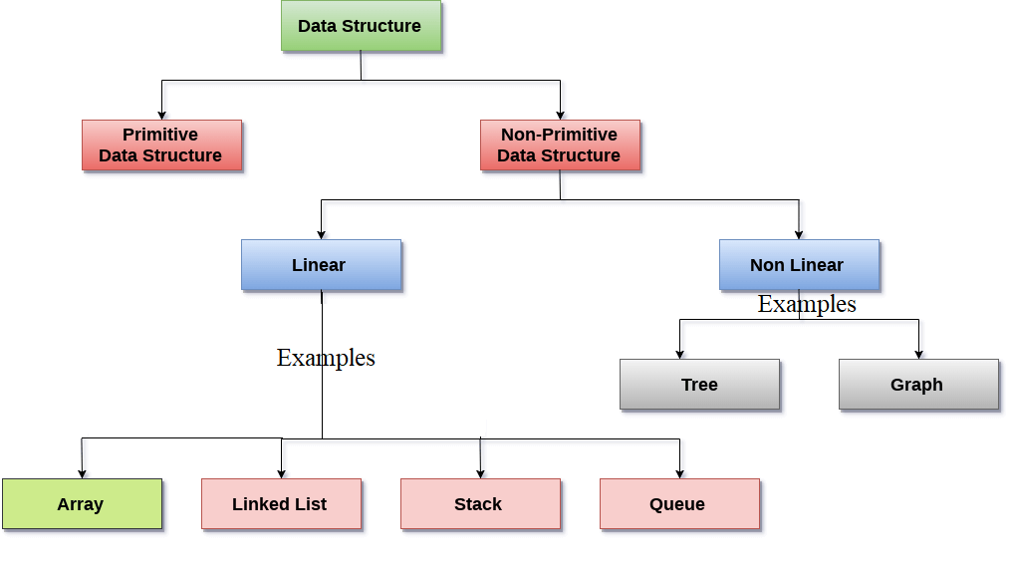
Types of Data Structures
Data structures are divided in to two categories.
Primitive data structures
The primitive data structures can be manipulated or operated by the machine instruction.
Example – int, float, char, etc are the some of the different data structures provided in c language.
Non-Primitive data structures
The data structures which can not be directly operated by the machine instructions. These are derived from the primitive data structures.
Example – Arrays, Structures, Stack, Queues, Linked Lists, trees, graphs, etc.

Slide 37
Types of Data Structures
The non-primitive data structures are divided into two categories:
Linear Data structure(Example – Array, Linked List, …)
0
1
2
3
4
5
6
7
8
9
myList
--
--
--
--
--
--
--
--
--
--
7042
7046
7050
7054
7058
7062
7066
7070
7074
7078
head
x2000
20 | x3000
30 | X1000
10 | NULL
x2000
x3000
x1000

Slide 38
Types of Data Structures
Non-Linear Data structure (Example – Graph,…)
V₁
V₂
v₃
v₄
v₅
v₆
v₇

Slide 39
Types of Data Structures
Linear Data structure – Collection of nodes which are logically (or physically) adjacent, i.e., logical adjacency is maintained by the pointers.
Linear relation ship –sequential memory locations or links
Example – Arrays, Linked Lists, Stacks, Queues, etc.
In linear data structures, each element has the successors and predecessors except the first and last element.
In linear data structure, single level is involved. Therefore, we can traverse all the elements in single run only.

Slide 40
Types of Data Structures
Non-Linear Data structure can be constructed as a collection of randomly distributed set of data items joined together by using a special pointer (tag). In non-linear data structure the relationship of adjacency is not maintained.
Example – Tree, Graph, etc.
In a non-linear data structure, single level is not involved. Therefore, we can’t traverse all the elements in single run only.

Slide 41
Example for demonstrating data structures
Data elements are: 20, 60,30,10,40,70,5.
Want to search element 5?
3
Using Non-linear
Data Structure
Binary Search Tree
Using Primitive Data Structures:
int a=20, b=60,c=30, d=10;
int e=40,f=70,g=5;
Compare each and every one find 5 is presented or not.
If( (a==5) || (b==5)||(c==5)||(d==5)||(e==5)||(f==5)||(g==5))
printf(“\n 5 is presented “);
1
Elements are arranged as nodes, relation between nodes : parent and child.
Right child value > Parent node value > left child value.
20
10
60
7 - comparisons
3 < 7 comparisons
5
30
70
Found at index 6
[0] | [1] | [2] | [3] | [4] | [5] | [6]
20 | 60 | 30 | 10 | 40 | 70 | 5
7 - comparisons
Non Linear Data Structure
Graph
40
4
2
Nodes are interconnected
Visit adjacency nodes
Using Linear Data Structure (Array):
int ar[8]={20, 60,30,10,40,70,5}
//Compare each and every one find 5 is presented or not.
for(i=0;i<7; i++)
{
if(ar[i]==5)
printf(“\n 5 is presented at index %d “,i);
}
20
60
1
10
1
3
70
2
4
5
3
30
40

Slide 42
Operations on Data Structures
Inserting:
to insert new element into data structure.
Deleting:
To remove element from data structure.
Traversing:
Visiting or accessing each element
for better performance, visit only once.
Searching:
search an element is presented or not.
return the location of item
Sorting:
To arrange the elements in order
Merging:
combining data items into a single list of items.
And many more…………..

Slide 43
Summary
This lecture
Presents the steps to follow for solving a problem.
Introduces the formal definition of an algorithm.
Stated the definition of problem.
Introduces what is data structure.
Introduces the ADT
Introduces the characteristics of Data Structure
Introduces the need of data structure
Introduces the advantages of Data Structures
Introduces the types of Data Structures
Examples for data structures
Operations on data structures

